Slide 1
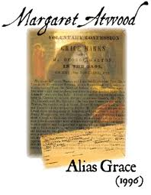
“Women’s History as Patchwork”
Dr. Hope Jennings
Wright State University

Slide 2
Writing Historical Fiction
“There is … no more reason to trust something written down on paper then than there is now. After all, the writers-down were human beings, and are subject to error, intentional or not, and to the very human desire to magnify a scandal, and to their own biases. I was often deeply frustrated, as well, not by what those past recorders had written down but by what they'd left out. History … is frequently reluctant about the now-obscure details of daily life. Nobody wrote these things down because everybody knew them, and considered them too mundane and unimportant to record. … If you're after the truth, the whole and detailed truth, and nothing but the truth, you're going to have a thin time of it if you trust to paper; but, with the past, it's almost all you've got.”
~ Margaret Atwood, “In Search of Alias Grace” (1514)
Notes:
Alias Grace recounts the “true crime” story of Grace Marks and her alleged murder of two people in the summer of 1843, which was one of the most sensationalized and reported murder trials of Victorian Canada.
Accounts of the trial and aspects of Marks’ life were well publicized and Atwood plays with notions of reality and fiction by offering a combination of real events mixed with her own imagination in an attempt to create a “complete” story.
In Atwood’s own explanation of how she approached writing historical fiction: “I felt that, to be fair, I had to represent all points of view. I devised the following set of guidelines for myself: when there was a solid fact, I could not alter it … but, in the parts left unexplained – the gaps left unfilled – I was free to invent. Since there were a lot of gaps, there is a lot of invention.”

Slide 3
Narrating the Past
“What does the past tell us? In and of itself, it tells us nothing. We have to be listening first, before it will say a word, and, even so, listening means telling, then re-telling. It's we ourselves who must do such telling, about the past, if anything is to be said about it; and our audience is one another.”
~ Margaret Atwood, “In Search of Alias Grace” (1515-16)
Notes:
Alias Grace explores the notion of truth and authority in all its forms, attempting to disrupt our notions of the past, including the historical record. Atwood plays with narrative structure, providing multiple and contradictory perspectives and accounts of the same event.
By providing this collection of points of view, Atwood lays out different interpretations of the events, demonstrating the confusion that surrounded the real court case and the inability of either proving or disproving Grace Marks’ innocence or guilt. This disrupts our ability to come to any solid conclusions, forcing us to question “truth.” The text does not attempt to solve all the puzzles of the crime, but it does present a patchwork story, details of which come from a variety of real sources as well as from Atwood’s imagination, thus leaving readers to come to their own conclusions.
Today, I’m primarily talking about these narrative strategies that Atwood employs in Alias Grace, which create not only a more rounded version of Grace Marks’ life but also speaks to the ways in which women writers have attempted to recover women’s history. By focusing on Atwood’s use of quilting as a structural and thematic metaphor throughout the novel, we gain a greater understanding of how quilting or patchwork has historically provided women with an alternate means of documenting their lives and experiences, which has often been obscured or erased by the historical record. In this sense, quilts function as an archive of women’s private and public histories, and as material objects that participate in creative visual culture, they contribute to broader forms of collective memory and storytelling.

Slide 4
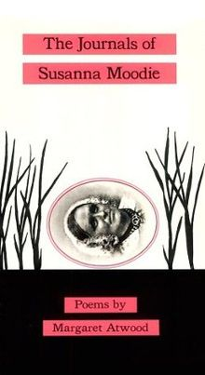
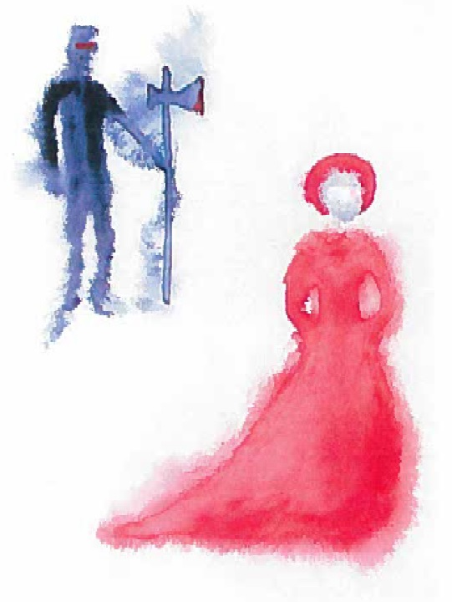
Historical Contexts
Notes:
Before discussing the connections between quilting, narrative, and women’s history, we should first explore several key historical contexts for Atwood’s novel and Grace Marks’ life. Although Alias Grace is considered to be Atwood’s first historical novel, since very early in her career she had been exploring Canadian historical themes and narratives in her poetry.
Most notably (at least in connection to Alias Grace), Atwood’s third poetry collection, The Journals of Susanna Moodie, published in 1970, is a poem sequence relating the life of Susanna Moodie, who emigrated from England to Upper Canada in 1832 and wrote about her experiences as a colonial settler; Moodie’s second book included a description of the Grace Marks’ trial and an eye witness account of Grace when she was held in the Toronto Asylum.
Similar to what we find in Alias Grace, throughout The Journals of Susanna Moodie, Atwood employs the motif and imagery of handcrafting, such as sewing, knitting, or embroidery, and Jennifer Murray observes how this form of domestic work (at least in Atwood’s writing) provides alternative “ways of conceptualizing history from a female point of view” (67).
In the 1978 collection, Two-Headed Poems, Atwood continued to explore events from Canada’s colonial past, including the Lower Canada uprising in 1838. In the prose poem, “Marrying the Hangman,” Atwood explores the obscure 18th century account of Francoise Laurent, a woman in Quebec who had been sentenced to hang for stealing and had managed to avert her fate by convincing the man in the cell next to hers to apply for the undesirable post of executioner and also marry her. According to Atwood’s historical note to the poem, other than letters of pardon this was the only way for someone under sentence of death to escape hanging – for a man to become a hangman, or, for a woman to marry one.
The story of Francoise Laurent clearly provides an historical antecedent to Atwood’s fictional retelling of Grace Marks’ story, since Grace (like Francoise) uses her voice, as well as her skill in sewing, to stitch together her story for Dr. Simon Jordan in the hopes that he will write a letter on her behalf, recommending if not a full pardon then a release from prison.

Slide 5
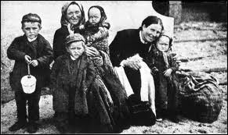
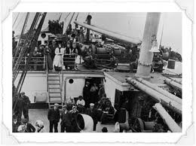
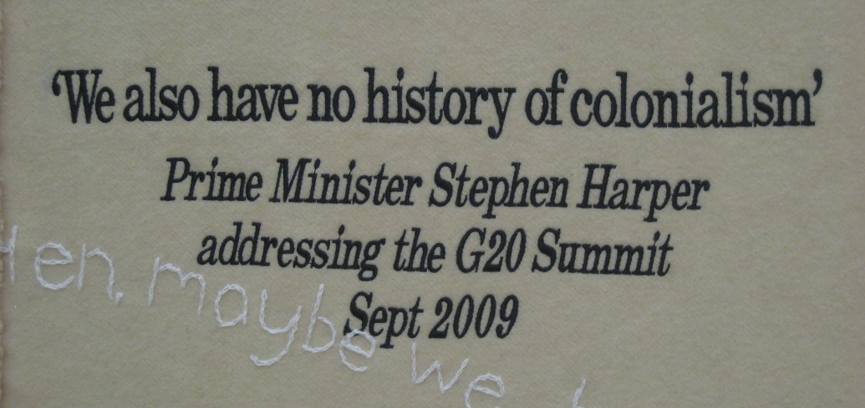
Irish Immigration & Colonialism
Notes:
As seen throughout her poetry and fiction, Atwood’s work often critiques Canada’s colonial history, particularly its settler expansionism that claimed native lands while erasing indigenous cultures, alongside the complexities of contemporary Anglo and French Canadians’ need for negotiating a postcolonial national identity in tension with the inheritance of their settler past.
In Alias Grace, Atwood specifically focuses on the 19th century class and ethnic divisions between the various settler groups, which drew clear lines between the established English elite and the newer Irish immigrants. At the height of the potato famine in Ireland (which was a British colony at this time), many emigrated to N. America for the promise of land, work, and greater freedoms; in 1855, according to British records, more than two million people had left Ireland; and by 1867, almost one-quarter of the entire population of Canada was Irish.
Through Grace’s narrative of her childhood, Atwood highlights the extreme deprivations of poverty in colonial Ireland and the extreme dangers of the trans-Atlantic crossing. Most ships were overcrowded and most people were not prepared for the length or hardships of the journey; the ships were referred to as Coffin Ships because of the number of deaths that occurred during the voyage and Grace loses her mother during their journey. Grace’s narrative also observes the social inequities that many Irish confronted once they’d reached Canada; upon arrival, many suffered further difficulties in the forms of unemployment, prejudice, and a climate much harsher than they were used to or had been prepared to face.

Slide 6
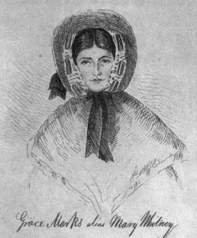
The “Real” Grace Marks
Notes:
Much of Grace’s narrative about the social conditions of life in colonial Canada stays true to what can be found in the historical record. As for the “real” or historical Grace Marks, she was a sixteen-year-old Irish immigrant, sentenced to life imprisonment for her role (which was never fully defined) in the murder of her employer, Thomas Kinnear, and his housekeeper, Nancy Montgomery. Kinnear and Montgomery were presumably having an affair, and many people speculated that Marks, who was recently brought into the Kinnear household as a servant, was jealous. Montgomery, after all, was a maid, not the mistress of the house, and supposedly Marks resented Montgomery’s airs of superiority.
At least, that is one version of the story. Marks provided three different and contradictory accounts of her involvement in the murders, including one in which she states that she could not remember what happened on the day of the murders and another in which she claims to have been temporarily possessed by a dead friend of hers (and Atwood, somewhat anachronistically in her exploration of psychoanalysis, plays with the possibilities of amnesia, trauma, repressed memories, and dual personalities throughout the novel as possible explanations for Grace’s role in the murders).
Another motive ascribed to Grace was madness or deviancy derived from a combination of her gender, class, and ethnicity. Atwood explicitly highlights these factors in her depiction of Grace as a “celebrated murderess” whose various sexualized, racialized, and criminalized identities remained central to the newspapers’ lurid and sensationalist reporting.

Slide 7
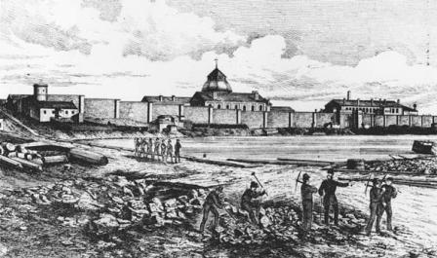
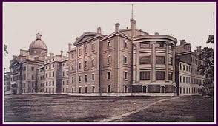
Kingston Penitentiary
Nineteenth-century illustration depicting prison laborers outside the Kingston Penitentiary
Toronto Lunatic Asylum
Notes:
After her trial, Grace Marks spent most of her adult life in prison, from the age of sixteen to her release at the age of 46. Atwood makes central to Grace’s narrative her experiences at the Kingston Penitentiary and the Toronto Lunatic Asylum, as these historical institutions provide a vehicle for exploring how the disciplinary practices of incarceration and medical treatment of madness influenced various 19th Century attitudes towards gender and class.
Previous to the 19th C., convicted criminals, the insane, and those who were in debt were all imprisoned together. The Kingston Penitentiary opened in 1835 (eight years before Grace Marks was sentenced), and the Toronto Lunatic Asylum was built in 1841 to provide a means for separating the insane (and criminally insane) from the rest of the prison population. The Penitentiary remains one of the oldest prisons in continuous use in the entire world; and was the first so-called modern prison built in Canada to take a different approach to incarceration – emphasizing reform rather than punishment. The Kingston Prison for Women, located across the street from the Penitentiary, was not built until 1934, and so prior to its opening, women continued to be jailed in the main building but segregated from the male population.
The Toronto asylum was more comfortable than the penitentiary, since it was one of the first buildings in Toronto to have running hot and cold water, steam heat, and ventilation. Like Grace, many prisoners were accused of faking mental illness in order to remain housed in the asylum, and like Grace, women prisoners exhibiting traits of insanity were often taken back and forth between the penitentiary and the asylum as doctors and prison officials tried to define these “female monsters” who did not easily fit into Victorian gender norms.

Slide 8
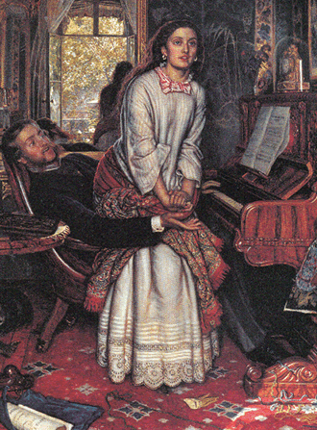
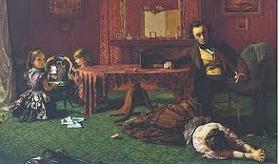
Victorian Gender Roles
Augustus Leopold Egg
The Past and Present I
(1858, Tate)
William Holman Hunt
The Awakening Conscience (1853-54, Tate)
Notes:
Nineteenth Century Canadian views of gender were heavily influenced by the Victorian ideology of separate spheres, which often positioned women in only one of two possible categories: the Angel in the Home or the Fallen Woman. In Alias Grace, the first is depicted as a helpless, passive or martyred victim and the second as a seductive whore and murderess, and Grace herself takes on the role of both depending on other characters’ points of view.
Gillian Siddall argues that the focus of the novel is on the ways in which Grace becomes an object of public fascination and discourse, and Victorian ideologies of femininity and sexuality are made visible in the public construction of Grace “as someone who strays from normative femininity”; for example, speculation around her presumed participation in the violent murders is often articulated through sexual fantasies that center on Grace’s physically attractive appearance as synonymous with dangerous seductive powers (131).
On the other hand, throughout her therapy sessions with Dr. Jordan, Grace also actively attempts to fashion her own self-representation, which is presented as a subversive act that crosses Victorian gender boundaries since autobiography was not considered an acceptable genre of women’s writing (128); moreover, Grace asserts herself as a keen social critic of a system that depends on the domestic labor of women while condemning them to a domestic sphere that does not ultimately protect them from either economic or sexual exploitation.
Thus, Grace is not just an object of speculation and curiosity, and her storytelling is not simply about women’s survival “but an autopsy of a world that has killed women’s spirits as well as their bodies. The real enigma of Grace,” as Barbara Hill Rigney notes, “is that she can resist the drama of her own story” through critiques of 19th Century poverty, servitude, and the medical treatment of madness (66).

Slide 9
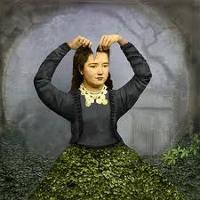
Mental Illness
“But when you go mad you don’t go any other place, you stay where you are. And somebody else comes in.”
Notes:
Through characters’ various speculations on the nature and treatment of mental illness, Alias Grace explores the notion of alternate identities, or alter egos, which is highlighted throughout the text, and most obviously in the novel’s title. Grace is presented throughout as a “double character,” as she tries to negotiate the gender stereotypes, roles, and expectations for women in the 19th Century. For example, Simon as well as other observers of Grace sense that she is innocent yet at the same time they suspect she is somehow guilty, believing she had been possessed by a kind of “feminine” madness when the murders were committed.
According to Grace, when a person goes mad, she is not the one in control of the behavior. The problem with this, though, especially in the contexts of determining someone’s guilt or innocence, as Grace observes, is that “when you go mad you don’t go any other place, you stay where you are. And somebody else comes in.” Grace herself would like to believe in her own innocence (and at times seems as uncertain of her guilt as anyone else); thus, she may give an alias for herself to the external world, but she also has an internal alias—a second self inside of her, which seems to have a life of its own. Whether this second self is indeed a double personality or a possession by Grace’s friend, Mary Whitney (which is indicated in the climactic séance scene), we are never definitively given this answer.
To employ Atwood’s own sewing metaphor, rather than entangling ourselves in the futile quest of determining Grace’s innocence or guilt, which Dr. Jordan attempts to do by obsessively (and often luridly) following the various threads of Grace’s narrative, and to the detriment of his own sanity, I would argue that Atwood directs our focus elsewhere. The ambiguity of Grace’s double, secret identity is not simply a plot device, or a vehicle for Atwood to explore various 19th C. attitudes toward psychology and spiritualism, but is closely tied to the coded language of quilts, which itself is linked to the subtly coded narrative that Grace provides Dr. Jordan, a narrative he cannot unravel because he doesn’t know how to “read” its textual cues.

Slide 10
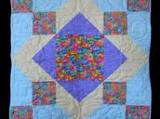
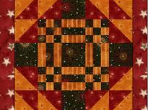
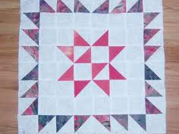
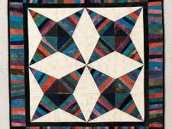
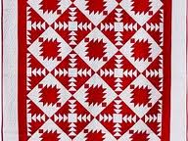
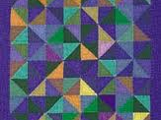
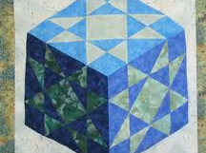
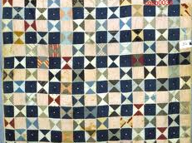
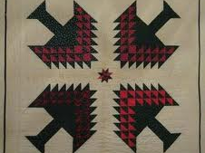
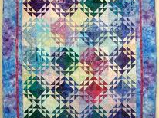
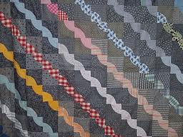
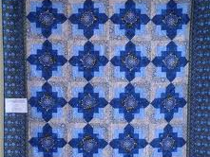
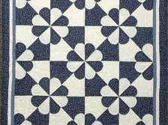
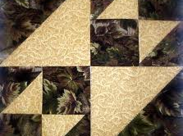
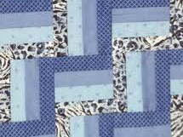
Alias Grace and Quilting
Notes:
While telling her story to Jordan, Grace works on various sewing tasks and often comments on quilting, embroidery, and other handcrafting skills as integral to her own and other women’s lives; thus, according to Siddall, she doesn’t simply verbalize her life story but uses quilting as a specifically feminine narrative mode, which “suggests that quilting provides women with a way discursively to resist powerful and repressive cultural formations of identity” (129). In other words, Grace’s skill with sewing and quilting represents the fact that she alone owns all the “pieces” of her story—indeed, she makes something whole from various scraps and fragments of memory.
She is literally and metaphorically re-sewing the pieces of her life together to get a sense of the whole by going through the exercise of recollecting for Jordan, and because her narrative is often coded through reflections on women’s domestic work, which Jordan overlooks as trivial, he thus ends up missing many of the clues Grace provides him concerning the details of her life and possible role in the murders.
However, the theme of quilting in Alias Grace does not simply reference women’s domestic roles and work, or Grace’s own storytelling method. According to Earl Ingersoll, “the patchwork trope functions as the organizing principle” for the novel – Atwood “patches” together different “found” texts, which are foregrounded as “received texts” that contrast with Grace’s own narrative, and together these create a larger pattern or understanding of not only Grace but the very nature of history and storytelling (385). Atwood thus also stitches together her own narrative structure by piecing and sorting information that has been gathered from different sources, while also playing with various literary genres and perspectives, while each section of the text is named after a specific quilt pattern, each of the names and designs suggesting the tone or focus of the chapter that is to follow.
Overall, the quilt metaphor refers to the piecing together of information that has been gathered from various conflicting sources, which then offers multiple interpretations without ever providing any definitive conclusions. This might be frustrating for readers who prefer to have narrative closure or answers, or even historical accuracy in their historical fiction. However, as I will now discuss in further detail, this is a narrative strategy that Atwood uses to disrupt or subvert dominant narratives about the past while exposing how women’s voices and lives have often been silenced by the historical record. Ultimately, quilting or patchwork is both a metaphor for Grace’s and Atwood’s storytelling while also a literal or material method of “telling history” differently.

Slide 11
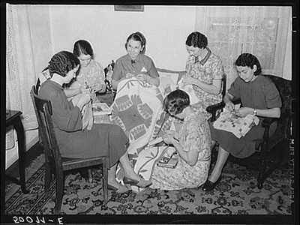
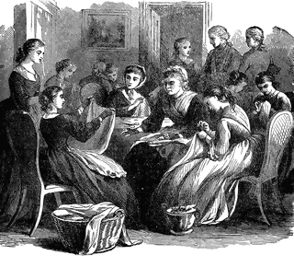
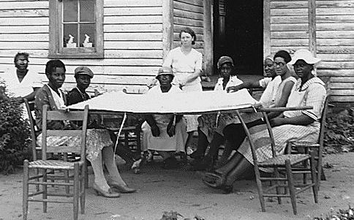
Quilting as Social Practice
Notes:
Margaret Rogerson observes: “The idea that women could be allowed a voice in the context of needlecraft and other forms of women’s work with textiles is not new in literary circles” (11), and Alias Grace contributes to a history of quilting/sewing themes in women’s writing.
Sewing and quilting however, don’t merely take on symbolic or metaphorical value in women’s texts because of their association with women’s work but more significantly, according to Sharon Rose Wilson, because “quilts are pieces of women’s lives and expressions of women’s feelings. In addition, quilting has usually been a social activity, a means for women to be with other women in a socially approved activity and a means for them to exchange family stories and vent anger or frustration with the ‘male world’ from which women have been excluded” (83)
Rogerson also notes that “the traditional sewing circle gives women an appropriate forum for gossip and the airing of views,” and yet Grace (as a marginalized figure due to her criminalized status) is fundamentally excluded from the sociality of women’s sewing circles and consequently friendships with other women, which we learn had been so central to her sense of self during her childhood and the years leading up to her imprisonment. Thus, as Rogerson argues: “In Alias Grace, the sewing circle is a social luxury that is denied to the central character. Although her stitching allows her a voice, her lack of a sewing circle of female friends voices her isolation. … [In the prison and asylum], no companionable conversation is allowed and the women’s voices are silenced” (11).

Slide 12
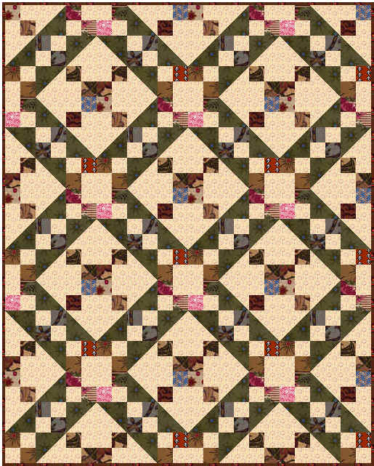
Quilting as Language
“Quilting is a ‘mother tongue’, a visual language and culture indigenous to women. It is a medium that has enabled, and continues to enable, women to create works in which they speak the truth about their lives. Quilt making has been a coded language, often overlooked in the general interpretations of human history.”
~ Mara Witzling, “Quilt Language: Towards a Poetics of Quilting” (619)
Notes:
Quilting is not only a social practice but “a complex system of signs” with its own discursive rules, categories, and frameworks for speech acts. According to Mara Witzling, there are “three ways in which quilts speak—through their formal qualities, their use of fabric, and their social context” and in this way “quilts are important historical documents that transmit information about women and their lives that might otherwise have been overlooked” (620)
Although quilting has a long history, dating as far back as aboriginal cultures and ancient Egypt, it begins to take on greater social meanings within colonial North America, first as an important domestic activity or chore for women, and then into a genre of communication rather than simple utility. Quilts developed complex codes of shared communal experience, and though Joan Mulholland notes that the “social or personal factors [that] led women to accept the extra workload involved in making quilts are unclear,” it seems quilting and patchwork provided them with opportunities to create something distinctive or beautiful; in other words, quilts answered women’s desires for making art and telling narratives (57-58), especially when we consider many women were not encouraged to write or paint, or may have been illiterate (something Alice Walker points out in her essay, “In My Mother’s Garden,” which examines the importance of quilting for women of color in the context of American slavery).
It is no surprise, then, that quilts are primarily constructed through a visual language “based upon patterns and their manipulation,” and they often “exemplify [a] design intelligence” through which women have been able to translate their “experiences into a form which evokes, but does not literally describe, the experience” (Witzling 620-22). Moreover, quilting seems to have developed specifically as not only a women’s language but a particularly coded language; as Mulholland notes, there had to be a “communally recognized standard of patchwork” and “a paradigm of communally agreed pattern types,” yet none of this was inscribed as part of a written record or manual; rather, there developed “a memory bank of quilts” that eventually developed into a canon – however, it was “a fluid canon” that heavily depended on intertextual communication between quilt creators and their readers (59-60).

Slide 13
Quilting as Reading
“Atwood’s extensive use of the quilt metaphor suggests that the reading of the novel is equivalent to the making up and assembly of the fifteen patterns presented in the book. The reader becomes a quiltmaker in the process of interpreting the novel, and, as with the transformation of the block patterns into a finished quilt, readings will vary according to the individual responses to the materials that have been provided.”
~ Margaret Rogerson, “Reading the Patchworks in Alias Grace” (9)
Notes:
Ultimately, Mulholland points out that quilting “became a way of disseminating women’s values and interests as well as their skills” but because “reading” quilts was often a private or limited activity, “their discursive power worked by repetition, and almost by stealth. Like an artwork on permanent exhibition, a quilt’s readers could examine it for meanings, could select and focus on the social value of their favorite colors and pattern pieces, could fantasize about them, and so supply personal interpretations for them” (58).
Likewise, the plurality of narratives and alternative plots in Alias Grace is often set against the unitary, linear “Male Narrative Paradigm.” Ingersoll argues that Grace’s narrative often suggests “the possibility of quilting as a feminine ‘coding’ [and thus] Atwood may be offering an encoded text for which the ‘code’ has been irrecoverably lost” (389). Although this often leaves us without closure or clear answers, at the same time it provides readers with a more active role in piecing together the disparate parts of the text, allowing us to come up with our own design and meaning (Ingersoll 393).
Accordingly, Atwood seems to be emphasizing that the ability to “read” a quilt (or text) is just as important as the skill needed in creating one. For example, according to Margaret Rogerson, Dr. Jordan can only interpret Grace’s narrative emphasis on the importance of sewing and quilting in her life through the limited values of Victorian domestic ideology, in which “sewing represents social harmony and a happy home” (7). In other words, Jordan’s view of Grace is constructed through his white middle class male perspective that reduces her sewing to an activity that is “both soothingly domestic and seductive” (8), an activity that is meaningless other than the pleasure it provides him, a solipsistic pleasure that ends up diverting him from hearing what Grace is actually disclosing about her life. As Rogerson argues, Jordan “consistently fails to understand that within the female discourse of quiltmaking, quilt patterns and the traditions and logic of their nomenclature evoke profound associations” (15) and that “for Grace, talking about quilts means talking about herself and about humanity” (16).

Slide 14
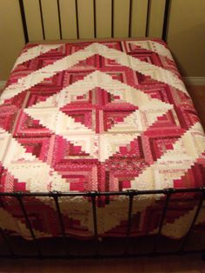
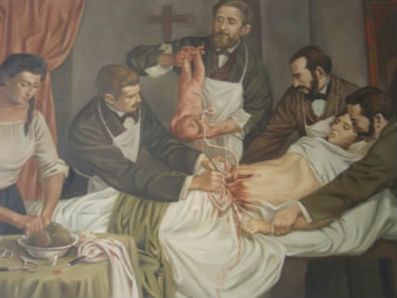
Quilting and Gender Identity
“And since that time I have thought, why is it that women have chosen to sew such flags, and then to lay them on the tops of beds? For they make the bed the most noticeable thing in the room. And then I have thought, it’s for a warning. … there are many dangerous things that may take place in a bed.” (161)
Notes:
Thus, during her sessions with Jordan quilting becomes a private, gendered form of discourse for Grace, whose voice has been silenced by the public discourse and years of isolation and imprisonment. As Atwood explains, Grace “is a storyteller, with strong motives to narrate but also strong motives to withhold; the only power left to her as a convicted and imprisoned criminal comes from a blend of these two motives” (1515).
Indeed, according to Rogerson, Grace’s repeated references to quiltmaking and quilts as metaphors for women’s experiences, including her own life experiences, “empowers Grace to speak in a language that is not universally accessible. In particular, it enables her to withhold her secrets from her male inquisitor” since he has no understanding or interest in “women’s culture and the discourse of needlecraft” (6).
Moreover, as Jennifer Murray observes, the language of quilting is not limited to Grace’s sense of individual identity but to a much broader gender identity: “The sewing of the quilt in Alias Grace acquires a symbolic dimension of a more collective nature when Grace situates it within its social context” and as “an important object in everyday life” – for instance, in the space of just a few pages, we learn “that the patchwork quilt was an important part of a young woman’s trousseau; that in order to consider herself ready to be wed, she should possess three of them; that the pattern of the quilt depended on its intended usage … [and] that they could be of different weights and materials depending on the season” (Murray 72). Even more striking is Grace’s reflection upon quilts as objects infused with meanings given to them by women: “And since that time I have thought, why is it that women have chosen to sew such flags, and then to lay them on the tops of beds? For they make the bed the most noticeable thing in the room. And then I have thought, it’s for a warning. Because you may think a bed is a peaceful thing, Sir, and to you it may mean rest and comfort and a good night’s sleep. But it isn’t so for everyone; and there are many dangerous things that may take place in a bed. It is where we are born and that is our first peril in life; and it is where the women give birth, which is often their last. And it is where the act takes place between men and women … and some call it love, and others despair, or else merely an indignity which they must suffer through. And finally beds are what we sleep in, and where we dream and often where we die.” (161)
In this passage, we begin to see how quilting and quilts do not simply signify gendered activity or objects, but are a highly “politicized” form of discourse. As Gillian Siddall argues, for Grace, quilting is transformed “from a highly gendered activity that signified women’s place in the domestic sphere into a medium for articulating an eloquent, albeit coded, resistance to the Victorian ideology of gender that has so profoundly shaped and constrained her life. … Grace characterizes quilting as one of the most important activities that a married woman undertakes to set up her home” while also associating it with a more sinister and threatening domesticity – ultimately, Grace presents “quilts as markers for women of the treacherous territory of the bed,” a territory that exposes the vulnerability of women’s bodies and determines the scope of their lives (137-38).

Slide 15
Quilting as Autobiography
Notes:
According to Joan Mulholland, quilting has historically functioned as a form of women’s autobiography. Early in its North American practice, creating quilt “albums” or “portfolios” was an important activity for young women to present themselves as “marriageable,” since sewing was viewed as a necessary domestic skill; the quilt portfolio also implied a close mother-daughter relationship figured in the contexts of a professional apprenticeship, with the mother as instructor and daughter as apprentice; the quilt portfolio thus demonstrated that the young woman had been educated in the community’s standards and values; and, as “a major speech event in a girl’s life,” it “could act as a sustained autobiographical narrative saying more about the maker than could an individual quilt” – in other words, the quilt portfolio was created and read as “a system in which each sign draws its value from its difference from and similarity to the others. So, not only was the girl judged by her work, but the set itself was experienced as a language lesson” (58-59).
Knowing the historical significance of a quilt portfolio in a young woman’s life adds a greater depth of understanding to Grace’s own narrative, and especially highlights not only why quilting is so important to Grace’s self-representation but also reveals her loss of community and the extent to which her voice has been silenced. Grace’s mother died on the voyage over to Canada; her closest friend, Mary Whitney, died of a botched abortion; her only other friend, Nancy Montgomery, was murdered (possibly by Grace’s own hand); and throughout her years of imprisonment, she is only permitted to make garments and patchwork for the benefit of upper middle-class women like the Governor’s wife.
We also gain insight into why Grace focuses so much on fabric and clothes throughout her narrative, and not simply because she was envious of Nancy Montgomery’s finer wardrobe (as Grace was accused in the murder trial), or out of some trivial dream of domestic accomplishment (as Dr. Jordan believes). Rather, fabric choice is a crucial element to the construction of any quilt narrative and its subtler, deeper meanings. Quilts were often made from pieces of cloth cut from dresses or other garments marking important moments and events in a woman’s life; also, women often exchanged fabrics with each other as gifts or mementos of their friendships; thus, different fabrics served commemorative, dedicatory, or thematic purposes; in this way, quilts represented women’s memories or autobiographies, and were personal texts “in which women were able to give voice to their emotions and ideas,” their experiences, ambitions, and desires; as such, according to historian Susan Behuniak, “‘Every quilt … is more than fabric. It is the preservation of a woman’s voice’” (JM 623, 626-628)
Also, similar to the writing of narrative – whether fiction, memoir, or history (at least according to Atwood’s postmodern metafictional sensibilities) – quilts experiment with “multiple levels of illusion,” and, according to Mara Witzling, indicate a “freedom inherent in the relationship between fabric and pattern” and symbolizes “that regardless of what we are given in life, we have an abundant choice of how to structure it” (622-23).

Slide 16
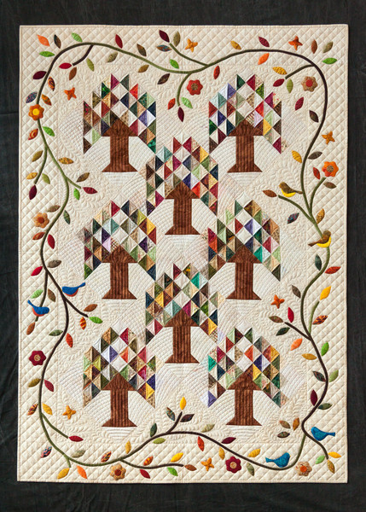
Grace’s Quilt Autobiography: “The Tree of Paradise”
Notes:
Ultimately, as Siddall reminds us, quilting is presented in Atwood’s novel as a flexible form that “allows for coded forms of resistance” and “social critique” while also helping Grace (and astute readers) in the interpretive task of “clarifying certain aspects of her life story” where Grace (and readers) are able to make “connections between design and meaning” (138).
This is all the more clear in Grace’s last quilt design, also the title of the last chapter of the novel – “The Tree of Paradise.” Grace has finally been freed from prison and is married to the man who accused her of murdering Nancy (a condition of her release). Grace narrates this final chapter to Dr. Jordan, although he is not present, and so it is the reader who remains her real audience. Grace tells us she is making a “Tree of Paradise” quilt, though this will not be used for the bed (she purchase a Log Cabin pattern for this), but instead, she is making it for her own private, individual pleasure; as Siddall notes, this “quilt is hers alone, and it seems to provide a resolution to her narrative at the same time as it surreptitiously suggests that she has reclaimed her narrative” from all the other versions that have been constructed for her (Siddall 139-40). Grace reworks the pattern to suit her own purposes and includes fabric from Nancy’s dress, Mary’s petticoat, and her own prison nightdress, and she informs us that she plans to “embroider around each one of them with red feather-stitching, to blend them in as part of the pattern. And so we will all be together” (460).
Grace’s quilt thus asserts what she could never make explicit in her sessions with Dr. Jordan, and not the truth of her guilt or innocence, but the truth of her own identity and experiences that holds the most importance: that she mourns the loss of her friends, the loss of a community that she’ll never know, while also expressing, as Siddall argues, a solidarity with other women “who were victims not of isolated violent incidents but of a broader set of social practices” (140). Even if this is a private message, too private to enact social change (at least in Grace’s lifetime), it provides Grace and by extension other women ownership over their own stories, confirming the ways in which quilts “offer alternative articulations of resistance to socially imposed categories of identity and power relations” (Siddall 140).
Margaret Rogerson, however, reads the significance of Grace’s “Tree of Paradise” quilt as something more ambiguous: although it provides Grace with a narrative form for constructing “the fragments of her life into a whole that is of her own fashioning. Yet the whole remains mysterious and the question remains as to whether [it represents] an innocent desire to create a memorial to the only female friendships that she had ever experienced, or a brazen celebration of a crime for which she feels no remorse”; moreover, “This Tree of Paradise quilt, like other nineteenth-century antique quilts in museums and family collections, has meanings that are not fully knowable and the bits and pieces of the history of its maker are not fully recoverable. Grace has asserted the wholeness of her life story in the Tree design, but, because she speaks in a quiltmaker’s idiolect, her meanings are unclear, perhaps even to herself” (21)

Slide 17
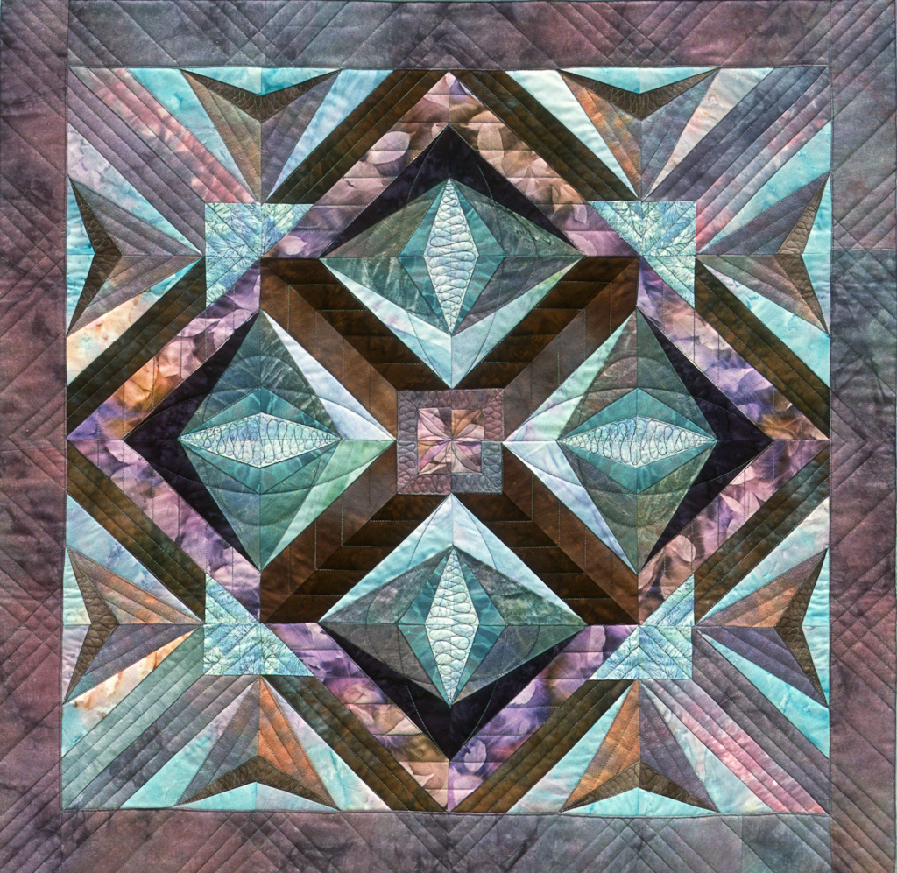
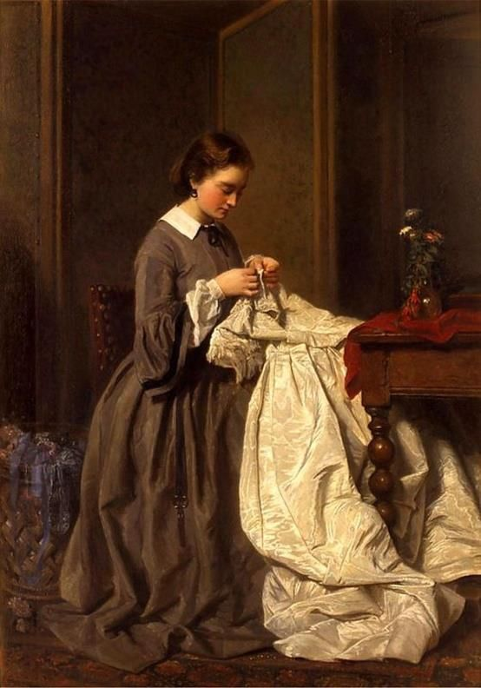
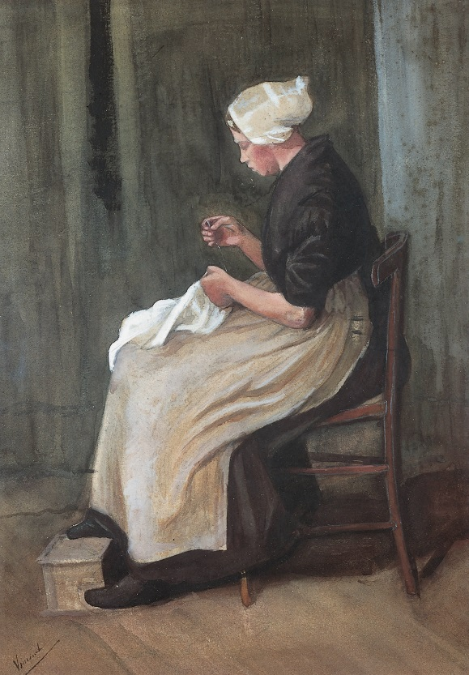
Quilting as “Herstory”
Notes:
However we choose to read Grace’s narrative confession in this final quilt, Gina Wisker argues that it is important to keep in mind that Grace’s story, as constructed by Atwood, is that “of a working-class immigrant woman, whose life would have remained silenced in record and narrative,” and because of the various shifting aspects of her tale, emphasizes “the constructedness of history and its partiality” (119).
Because reconstructing always implies constructing, Wisker claims: “It can be argued that the quilting or patchwork nature of the ways in which [Grace] tells her tale undercuts the socially and historically dominant modes of constructing and representing women’s lives” (128); for example, because of Grace’s “amorphous” tale, Simon “merely discovers a version of her history constructed to fit his [own] obsessions” (129).
Atwood is, according to Wisker and many other literary critics, “problematising the fixed nature of history” and uses “evidence” that had accumulated around Grace alongside her own imagined life story to expose how no matter how much research one does, it cannot ever fully bring us to the “truth” of what really happened in the past (119-121). As Atwood informs us: “I am not one of those who believes there is no truth to be known; but I have to conclude that, although there undoubtedly was a truth – somebody did kill Nancy Montgomery – truth is sometimes unknowable, at least by us” (1515)
Thus, according to Jennifer Murray, attempting to answer questions of Grace’s guilt leads us to the wrong conclusions, at least when it comes to the possibility of ever fully knowing the past: “There is no final, absolute, right perspective; there are only different ways of understanding. And of course, we are being reminded that this also applies to all interpretative practices, whether they are historical, literary, or other” (76).
Above all, Murray notes that Grace provides a feminine-history (or herstory) that “develops a personal perspective on social life rooted in the material conditions of her existence” (79), and yet, according to Mara Witzling’s description of quilting as a form of poetics that belongs to a folklore system, women’s quilt stories are often dismissed because they are not “high art” (628); and precisely because they signify “elements of everyday, embodied life,” quilts not only tell a different kind of history, “the metaphor of piecing suggests an alternative mode of artistic practice, also oppositional to the current western view of the production of art” – in other words, “piecing is decentered activity—one can simultaneously work on many squares before putting them together into a completed quilt” and so this “process of collecting and assembling ephemeral but evocative fragments into a form that can be read as a narrative is in itself usually gendered as feminine” (629).

Slide 18
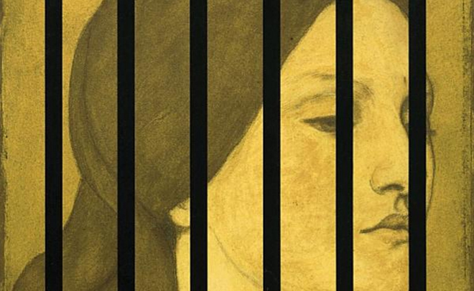
Women’s History as Patchwork
“Perhaps,” says Simon, “we are also … what we forget.”
“If you are right,” says Reverend Verringer, “what becomes of the soul? We cannot be mere patchworks!” (AG 406)
"The past no longer belongs only to those who once lived in it; the past belongs to those who claim it, and are willing to explore it, and to infuse it with meaning for those alive today. The past belongs to us, because we are the ones who need it."
~ Atwood, “In Search of Alias Grace” (1516)
Notes:
Verringer expresses a sense of horror that we might be reduced to “mere patchwork”; clearly in his estimation something associated with women’s work lacks value. Interestingly, there is no block or pattern design directly named for “Women,” yet since the Second Wave women’s movement of the 1970s, we have seen a growing historical awareness of the importance of quilting as a communicative form and genre specific to women’s labor, women’s experiences, and women’s creative cultural, social, and political production (Mulholland 68)
According to Elaine Showalter, “the metaphor of piecing ‘is central to the historical tradition of American women’s writing’, because ‘piecing … reflect[s] the fragmentation of women’s time, the scrappiness and uncertainty of women’s creative or solitary moments’” – however, as Witzling observes, for these very same reasons, “sewing as women’s work began to take on a negative connotation, in that in some quarters it became viewed as a means to women’s oppression,” and women’s writing itself has often been dismissed, according to the poet Roethke and several characters in Alias Grace, as mere “embroidery of trivial themes” (630).
Atwood’s own (re)writing of Grace Marks’ life provides us with a different understanding and appreciation of quilting as a form of self-empowerment and narrative response to [women’s] oppression; Alias Grace engages with and continues a long tradition of quilt stories in women’s writing to indicate how “patchwork [is] peculiarly appropriate to styles of narrating the self” through the accumulation of disparate and discrete fragments that might be patterned and stitched together into a new arrangement that makes possible new ways of understanding not only an individual life but the social, cultural, and political patterns that determine how we remember that life (Floyd).
As Janet Floyd explains, “Patchwork quilts can be understood … as histories that ‘arrange’ traces of the past” (38), and in this way, quilt stories (such as Alias Grace) “raise questions about the experience of recalling the past” by highlighting “the politics of cultural memory, that is, whose past is remembered and whose is forgotten” (55); thus, as Floyd goes on to theorize, women’s history as patchwork includes a reflection on the “disjunctions of past and present with a sense of what we prefer not to remember” and through the uses of quilts as material archives of women’s lives, we are “offered a way of looking at the past in an artifact that brings the past, in all its confusions and heterogeneity into the present. The result extends none of the comforts that we expect of the quilt, but rather a finer [and more complicated] sense of what we do when we recollect the past” (55).

Slide 19
Works Cited
Atwood, Margaret. Alias Grace. New York: Anchor Books, 1996.
Atwood, Margaret. “In Search of Alias Grace: On Writing Canadian Historical Fiction.” American Historical Review (December 1998): 1503-1516.
Floyd, Janet. “Back into Memory Land? Quilts and the Problem of History.” Women’s Studies 37:1 (November 2008): 38–56.
Ingersoll, Earl G. “Engendering Metafiction: Textuality and Closure in Margaret Atwood’s Alias Grace.” The American Review of Canadian Studies (Autumn 2001): 385-401.
Mulholland, Joan. “Patchwork: The Evolution of a Women’s Genre.” Journal of American Culture 19:4 (Winter 1996): 57-69.
Murray, Jennifer. “Historical Figures and Paradoxical Patterns: The Quilting Metaphor in Margaret Atwood’s Alias Grace.” Studies in Canadian Literature – Etudes en Litterature Canadienne 26:1 (January 2001): 65-82.

Slide 20
Rigney, Barbara Hill. “Alias Atwood: Narrative Games and Gender Politics.” Bloom’s Modern Critical Views: Margaret Atwood – New Edition. New York: Bloom’s Literary Criticism. 59-66.
Rogerson, Margaret. “Reading the Patchworks in Alias Grace.” The Journal of Commonwealth Literature 33:1 (March 1998): 5-22.
Siddall, Gillian. “‘That is what I told Dr. Jordan’: Public Constructions and Private Disruptions in Margaret Atwood’s Alias Grace.” Bloom’s Modern Critical Views: Margaret Atwood – New Edition. New York: Bloom’s Literary Criticism. 127-142.
Wilson, Sharon Rose. “Quilting as Narrative Art: Metafictional Construction in Alias Grace.” Bloom’s Modern Critical Views: Margaret Atwood – New Edition. New York: Bloom’s Literary Criticism. 79-91.
Witzling, Mara. “Quilt Language: Towards a Poetics of Quilting.” Women’s History Review 18:4 (September 2009): 619–637.

