Slide 1
Intro to Literary Criticism & Theory
ENG 3060: Intro to Literary Study
Dr. Jennings

Slide 2
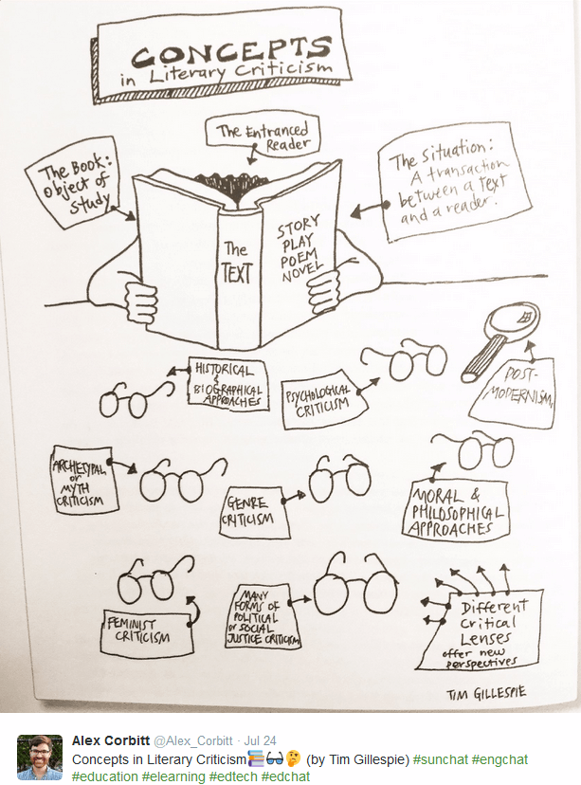
What is Literary Criticism?
The study, discussion, evaluation, and interpretation of literature, including the classification by genre, analysis of structure, and judgement of value.
The method used to interpret any given work of literature—in other words, the different schools of literary theory provide us with lenses to analyze important aspects of the literary work.

Slide 3
Why do we have to analyze everything?
Talking about experiences enhances our enjoyment of them
Talking about experiences involves the search for meaning which increases our understanding of them
Because Socrates said so: "The life which is unexamined is not worth living."
  Literary criticism helps us to understand important elements of the text
  its structure
  its context: social, economic, historical
  what is written
  how the text manipulates the reader

Slide 4
To further explain …
Literary criticism helps us to understand the relationship between authors, readers, and texts.
The act of literary criticism ultimately enhances the enjoyment of our reading of the literary work.
Literary criticism has two main functions:
To analyze, study, and evaluate works of literature.
To form general principles for the examination of works of literature.

Slide 5
Definition and Uses of Literary Criticism
“Literary criticism” is the name given to works written by experts who critique—or, analyze—an author’s work.
It does NOT mean “to criticize” as in complain or disapprove.
Literary criticism is often referred to as a “secondary source” because it is used to analyze your primary work—the work or text (poem/novel) you are reading.
Literary criticism is used by people who want to use an expert’s opinion to support their own ideas; it is used by readers to analyze, NOT by authors to write.
Therefore, when you begin to analyze your short story (for the research essay), you’ll make use of expert, reliable literary criticism to support your opinion—your thesis—which you will develop for your paper.

Slide 6
Literary Theory

Slide 7
What is literary theory?
The capacity to generalize about phenomena and to develop concepts that form the basis for interpretation and analysis—in this instance, of a “literary” text.
In this class you’ll learn about some of the various theoretical PARADIGMS used in literary criticism
Formalism & New Historicism
Structuralism & Deconstruction
Reader Response
Biographical& Psychoanalytic
Feminist, Gender, and Queer Theory
African American & Ethnic Studies
Postcolonial Literary Criticism
Marxist Criticism
New Historicism & Cultural Studies

Slide 8

There are so many possible answers …
Any piece of text can be read with different sets of “glasses,” meaning you are looking for different things within the text.
Different approaches or lenses help us to discover rich and deeper meaning
Each lens has its strengths and weaknesses
Each lens is valuable
Try to become a pluralist rather than an inflexible supporter of one specific lens or theory

Slide 9

For example, upon seeing an orange…
Formalism – What shape and diameter is the orange?
Reader Response – What does the orange taste like? What does the orange remind the reader of?
Psychoanalytical – I want this orange now! Will I get in trouble if I eat it?
Gender Theory – What possibilities are available to a woman who eats this orange? To a man?
Marxist Theory – Who owns this orange? Who gets to eat it?
Postcolonial Theory – Who owns the orange? Who took it away?

Slide 10
Golden Rule:
Literary Criticism & Theory are Flexible
Remember, one need not be a Marxist to use a Marxist approach, any more than one needs to be a woman to use a feminist approach.
Any critic can take any approach that helps them explain what they think the author is saying in his/her work.
Once you have decided what you think the author of your novel is saying—what his/her message is—you can then decide on which critical approach you think will work best to support your opinion.

Slide 11
Critical Approaches:
Formalism & New criticism
Structuralism & Deconstruction
Reader Response Theory

Slide 12
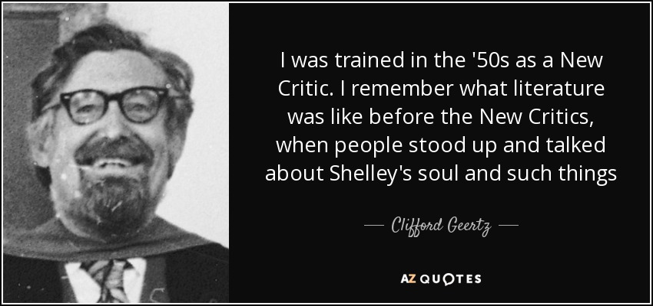
Formalism and New Criticism
Early to mid 20th C. critical approach that changed the way we read and study literature
Moves away from analysis of development of English language and reverence toward “Great Authors” to focus instead on the text itself
Interprets meaning from how the parts of a text relate to each other and form a whole
Practices close reading and explication of formal literary components

Slide 13
Formalism vs. New Criticism
Formalism ignores the author’s biography and focuses only on the interaction of literary elements within the text; emphasizes plot, narrator, structure, etc.
New Criticism varied from Formalism in that New Critics focus more on image, symbol, and meaning.
Traditional Formalists often attacked New Critics for their lack of attention to the form of the work.
Today, few critics adhere only to Formalist or New Criticism approaches; however, its back-to-the-basics approach pervades many other critical theories.
It’s what you do most often in literary study; works best when applied to poetry and short fiction.
Has the advantage of forcing writers to evaluate a work on its own terms rather than to rely on “accepted” notions of the writer’s work

Slide 14
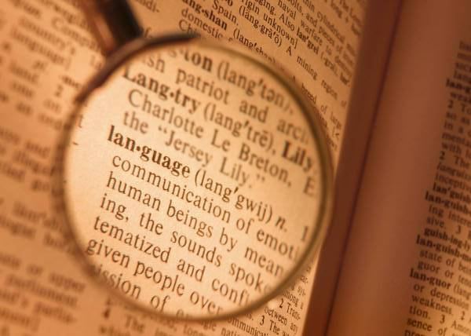
Close Reading
Meaning resides in the text—not in reader, author, or world
Texts may contain numerous messages, but must have a unifying central theme created by the perfect union of all artistic elements.
Texts are artistic creations
The methodology for finding meaning is clear-cut; the tools are unique to literary analysis

Slide 15
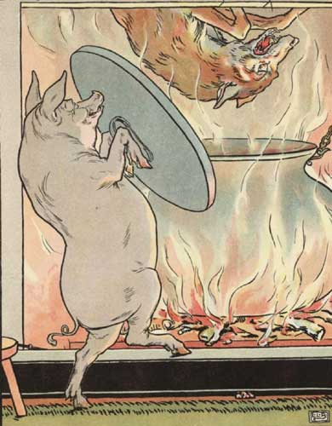
A Close Reading of
“The Three Little Pigs”
What does the wolf symbolize?
Notice the consonance/rhyme of “I’ll huff and I’ll puff…”
How does the story foreshadow the final fate of the pigs?
What does the wolf’s dialogue tell us about his character?

Slide 16
Structuralism/Poststructuralism
Arises in reaction to liberal humanism and essentialism; key influence in development of interpreting literature and using theory
Works against the purely text-based readings favored by New Criticism
Things cannot be understood in isolation but in the context of the larger structures to which they belong
Meaning is always located outside—things do not contain an essential truth or nature, and so meanings are attributed to things by the human mind
This methodology can end up taking you further and further away from the text into more abstract questions of genre, history and philosophy

Slide 17
The Structuralist Process
Scientific approach to literary analysis: structure of language as a logical sign system determines meaning—moves from the particular to the general
Two levels of language: langue (“the King’s English”) & parole (everyday speech)
Interprets a text or part of a text by taking its language apart (word derivations, sentence syntax, etc.)
The individual work is read within the wider structure/system – or – the structure/system is of greater importance than the individual item/work
Culture itself is read as a language through codes or systems of signs

Slide 18
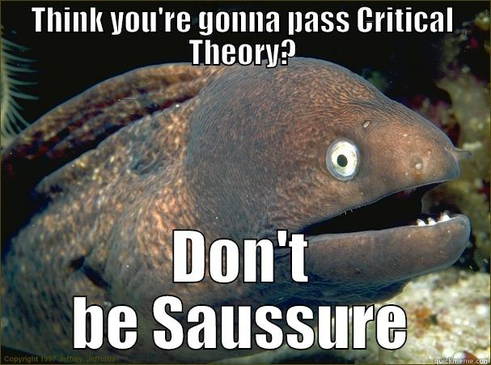
Ferdinand de Saussure’s Theory of Language
Language is first and foremost a social contract; a system of signs expressing ideas
Signs cannot exist in isolation – or we would not have language – hence signs work within a larger system or structure of meaning
As a social convention, language (and its meaning) is arbitrary;
As associative, it is relational and constructed in a chain of difference with no fixed meaning;
Language is both individual and social; an established system and an evolution; it is always in the present and of the past
Focus must be on linguistic structure (not semantics), where structure is understood as a social product, or, a body of conventions

Slide 19
Major implications for literary study:
Argues literary texts can be seen as manifestations of a literary system (such as narrative), the underlying rules of which might be understood, thus making literary criticism a more ‘scientific’ discipline;
Rejects historical explanations of literary phenomena, especially research into the ‘origins’ of meaning;
Emphasizes the collective or social construction of meaning in the production and reception of literary texts;
Works against naïve theories of literary ‘realism’

Slide 20
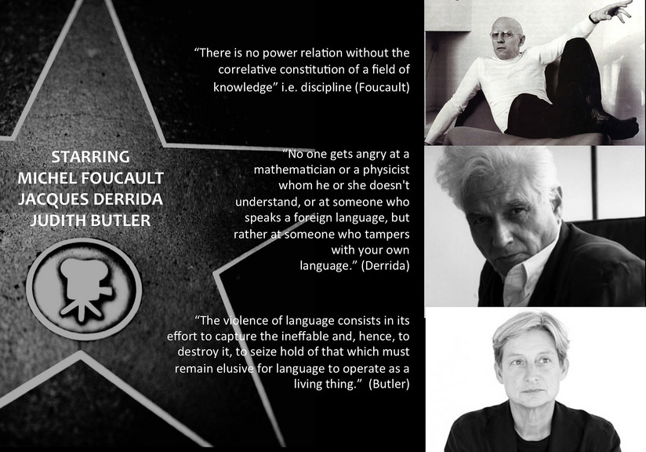
Deconstruction
Building on structuralism, emphasizes intense focus on language and text but allows for role of reader and critic constructing meaning
Disrupts notion of fixed truths or ‘real’ meaning---if we can understand things only in terms of other things, then perhaps there is no center point of understanding but only an endlessly interconnected web of ideas leading to other ideas
Often aims to break down the parts of the text or its use of language to examine the underlying ideologies or belief systems implicitly articulated therein.

Slide 21
Deconstruction
Insists on logical impossibility of knowledge that is not influenced by language AND YET Language is incapable of directly representing reality
Jacques Derrida (1930-2004) argues for tracing the way texts imply the contradiction of their explicit meanings
  aporia: irresolvable doubt/openness/gap when grounds of conviction fall away; meaning/truth is not fixed but circulates and is constructed through discourses: competing systems of meaning; exposes and unravels binaries that construct power, status, and hegemony (différance; the Other)
Rejects traditional notion of author as creative origin of the text; shifts to creative power of language and the work of reading/interpretation in detecting gaps and contradictions (Roland Barthes, “Death of the Author”)
So, much like New Criticism, this approaches closely focuses on the text and language but also emphasizes the role of the reader

Slide 22
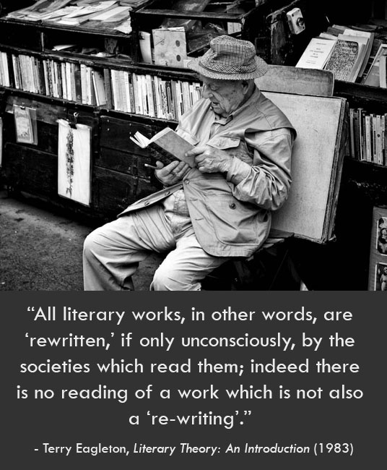
Reader-Response
Attempts to understand the process by which we make meaning out of words on a page
The text is an interaction between author and reader; incomplete without the reader bringing own unique insights
Reading viewed as an act of creation; focuses on gaps within the text out of which the reader brings meaning to the text

Slide 23
Reader-Response Criticism
Sees the reader as essential to the interpretation of a work.
  Each reader is unique, with different educations, experiences, moral values, opinions, tastes, etc.
  Therefore, each reader’s interaction with a work is unique.
Analyzes the features of the text that shape and guide a reader’s reading.
Emphasizes recursive reading—rereading for new interpretations.
Meaning ultimately resides in the reader’s mind or the consensual “mind” of a community of readers (this class, for example)
A text’s truth is relative—readers may reach the same conclusions about a work, but approach the task quite differently

Slide 24
Criticism of Reader-Response Criticism
Reader-response theory has been criticized as being overly impressionistic and guilty of the affective fallacy (too focused on the emotional effect of the work); less tactful critics have plainly said that it is not intellectual.
These attacks resulted in an adaptation of reader-response criticism called reception theory.
Reception theory is applied to the general reading public rather than an individual reader.
Each generation has different experiences, values, issues, etc.
Therefore, each generation will read a work differently.
Reception Theory

Slide 25
Critical Approaches:
Feminist, African American, Ethnic and Postcolonial Literary Criticism

Slide 26
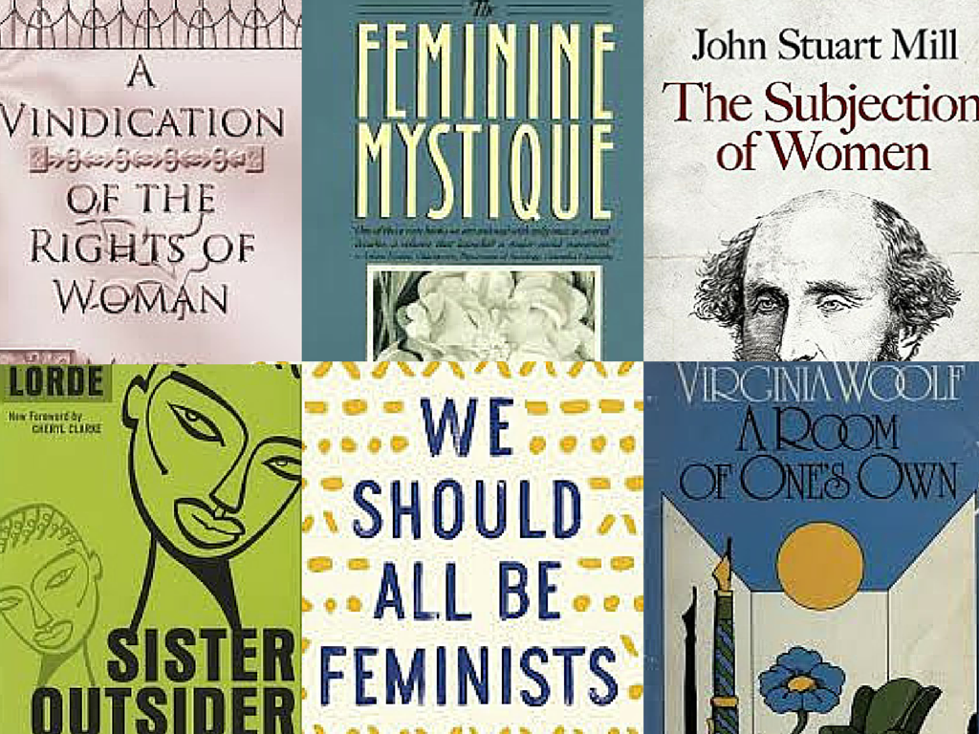
Feminist, Gender, and Queer Literary Criticism
Focuses on roles and representation of women in literature and culture; recovery of women’s writing within or outside the canon
Examines gender roles or relationships between the sexes as formed within culture and represented in the text, such as socio-cultural norms of masculinity and femininity
Disrupts heteronormative/sexist readings of texts and unsettles notions of fixed identity, questioning the terms of difference

Slide 27
What do we mean when we say “Feminist Literary Criticism”?
The phrase “Feminist Criticism” is an umbrella term for several varieties of critical analysis and interpretation of literature that use as a base some of the assumptions of the feminist movement.
Several other distinct types of criticism have branched off from Feminist Criticism—for example, Queer Theory and Gender Studies; both grew out of ideas originally developed by feminist critics.
Feminist Criticism and related theories are unapologetically political—critics who use these theories share the strong belief that examining literature through the lens of Feminist Criticism can be a tool for social and political awareness and for change.

Slide 28
Important Terms
Patriarchy: a system of beliefs and social practices that supports male dominance by denying women access to power, privileging issues/voices that are seen as “masculine” over those that are “feminine,” and exerting control over women’s bodies and sexualities.
Gender: A socially constructed set of expectations for what is “masculine” and what is “feminine.” (As opposed to “sex,” which is biological.)
Essentialism: The belief that every woman is inherently different because she is a woman. (Some early feminists used this idea to say that these differences should be identified and celebrated, but many feminists now see essentialism as outdated and prone to abuse.)

Slide 29
What questions might a feminist critic ask?
In what ways is patriarchy present in a particular work? How are the effects of patriarchy evident in the lives and attitudes of the characters? Do any characters show signs of resistance to patriarchy? If so, how is this resistance portrayed?
How are the concerns unique to women in a particular place/time portrayed in the work? To what extent does this portrayal value or critique those concerns?
To what extent does the representation of women (and men) in the work reflect the time and place in which the work was written? Does the author present the work from within a predominantly male or female perspective?
How are the relationships between men and women presented in the work? How do the facts or contexts of the author’s life relate to the presentation of men and women in the work? How do other works by the author correspond to this one in their depiction of the power relationships between men and women?

Slide 30
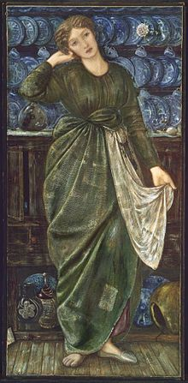
Example: A Feminist Reading of Cinderella
As a single, young woman, Cinderella is without means or opportunity because she is unattached to a father or a husband.
It is only through the magic of a fairy godmother that she can be made presentable and meet the prince AND he is the only means of her escaping her plight.
What skills does she have? She is beautiful, can sing well, and is kind. These are highlighted as the desirable qualities in a woman (hence, her UGLY stepsisters who are portrayed as undesirable).
A Feminist Critic might conclude that this story depicts the historical and economic realities of women’s lives, or, that it represents oppressive, patriarchal gender expectations of women.

Slide 31
Gender Studies & Literary Criticism
Gender criticism analyzes literature specifically through the lens of socially-constructed gender roles.
Many Gender Critics see a difference between gender (which is socially constructed) and sex (which is biological).
This means that ideas about "typically" masculine or feminine traits and behaviors are products of culture and social conditioning.
Gender Critics are interested in how works of literature either support or undermine the "standards" of masculine/feminine behavior and identity held by the culture in which they were produced.

Slide 32
Queer Theory & Literary Criticism
A newer segment of gender criticism—queer theory—emerged in the early 1990s out of the fields of LGBT studies and feminist studies:
  explores and challenges the way in which heterosexuality is constructed as normal, and the way in which media/culture has limited the representations of gay men and women.
  challenges the traditionally held assumptions that there is a binary divide between being gay and heterosexual; also often suggests sexual identity is more fluid (just as gender is fluid and non-binary)
When examining canonical or older literary texts, queer theory looks for the influence of homosexuality; however, research of this type is fairly difficult because homosexuality was largely suppressed in Europe and America, and it hasn’t been openly discussed until the last few decades.

Slide 33

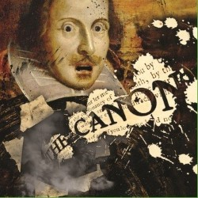
A Note on the "Literary Canon"
Definition of “Canon:” Originally, the term "canon" applied to the books of the Bible that were accepted as "divinely inspired." (The word "canon" comes from a Greek word meaning "rule" or "measure.") Therefore, the group of books that was accepted at any given time was referred to as the "canon of scripture," and books outside of that canon were referred to as "non-canonical."
The idea of the "Literary Canon" says that over time, teachers, academics, writers, and public opinion have, consciously or unconsciously, chosen works that are considered "worthy" of study.
This also means that there must be other works that are not "worthy" of study. (Please note that there was never an actual list of works in the literary canon, and works have risen and fallen in status over time.)
For much of history, the "literary canon" in Western literature (used broadly to mean literature of places that have their foundation in Greek and Latin cultures… meaning Europe and most of the Americas post-Columbus) has been written by white men.

Slide 34
So What Does the History of the “Literary Canon” Mean for Feminist Critics?
Feminist Critics are often interested in literary representations of women, and in bringing attention to works by women that have historically been overlooked.
Feminist Critics believe that for much of history, the "literary canon" and the field of literary criticism have both been dominated by men, and they seek to expose the effects of this patriarchal mindset.
By looking at the ways that women's concerns and women's writing has been marginalized, they seek to address the imbalance that has traditionally persisted in favor of men's writing and men's concerns.
Questioning and disrupting the “literary canon” is of equal concern to other critical approaches that examine historically marginalized groups—LGBT peoples, peoples of color, colonized peoples—as found in African American, Ethnic, and Postcolonial Literary Criticism.

Slide 35
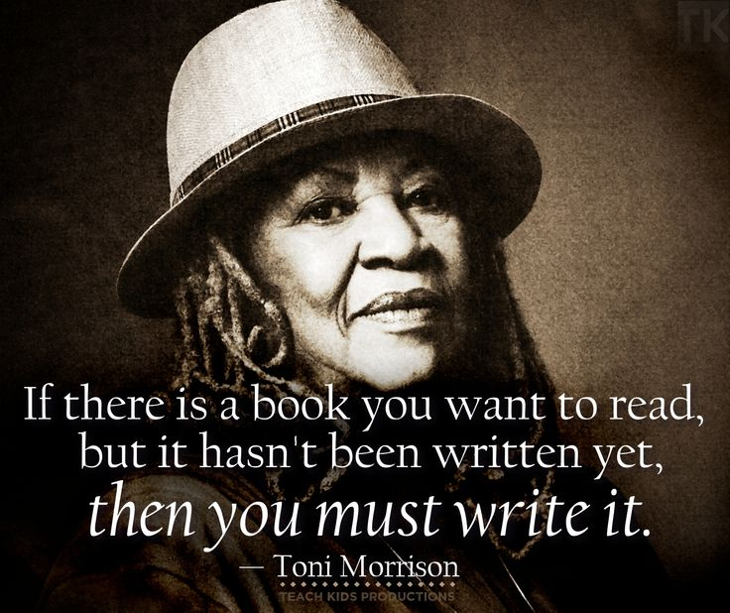
African American and Ethnic Literary Criticism
Provides a critical lens for examining the historical construction of race, racialized “others,” and subordinated or neglected literatures and literary traditions of people of color
Ethnic studies also places emphasis on borders and mixing of identities, cultural traditions, and literary forms

Slide 36
African American Literary Criticism
This approach explores the significance of the African American experience and derives from a sense that black writing and experience comes out of a sociological, political, ideological and cultural situation marked by oppression and separation.
African American literary critics argue that African American literary traditions:
  are tied to African language, cultural practices, and attitudes;
  have been formed through the experiences of racial violence and oppression;
  have lived through and survived a history of slavery and troubled negotiations with white culture;
  and are often focused on challenging the whole idea of "race” in order to claim a black identity that is more fluid and/or not determined by white culture.
For example, in Whiteness and the Literary Imagination, Toni Morrison argues that in cultural, ideological, and political terms, race is essential to defining American identity: “If one says someone is an American, that means they are white, unless otherwise noted -- the 'white' is automatic".

Slide 37
History of African American Literature
Periods of Study: Colonial, Antebellum, Reconstruction, pre-World War II, Harlem Renaissance, Naturalism and Modernism, Contemporary
Much of early African American literature was a response to racism, as "proof“ of black humanity and intelligence.
The Harlem Renaissance was an important cultural movement that spanned the 1920-30s—this was an explosive time of literary and artistic creation within black culture and was also known as "the new negro movement.”
African American literature represents in their own voices the struggles and experiences of African and African American peoples; it is also as an assertion of the right to express themselves and create their own literary tradition.
African American literature is found not only in written forms, but is also incorporated in oral forms such as; spirituals, sermons, gospel music, blues and rap.

Slide 38
U.S. Ethnic Literary Studies
Latina/o Writers
Problem of naming Latina/os=Latinx
Gender differences
History of the United States and Mexico
Gloria Anzaldúa; code-switching; mestizaje
Asian American Writers
Autobiography, conflicted cultures and gender roles (“west” vs. “east”)
Immigrant experience (paper sons and picture brides)
Native American Literatures
Oral versus written traditions, traditional versus mainstream
ritual, performance, community; art not disconnected from everyday life

Slide 39
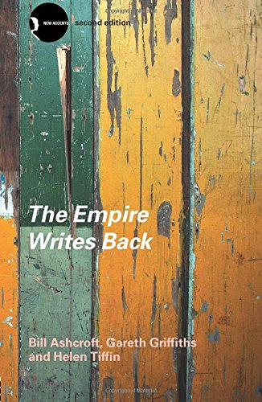
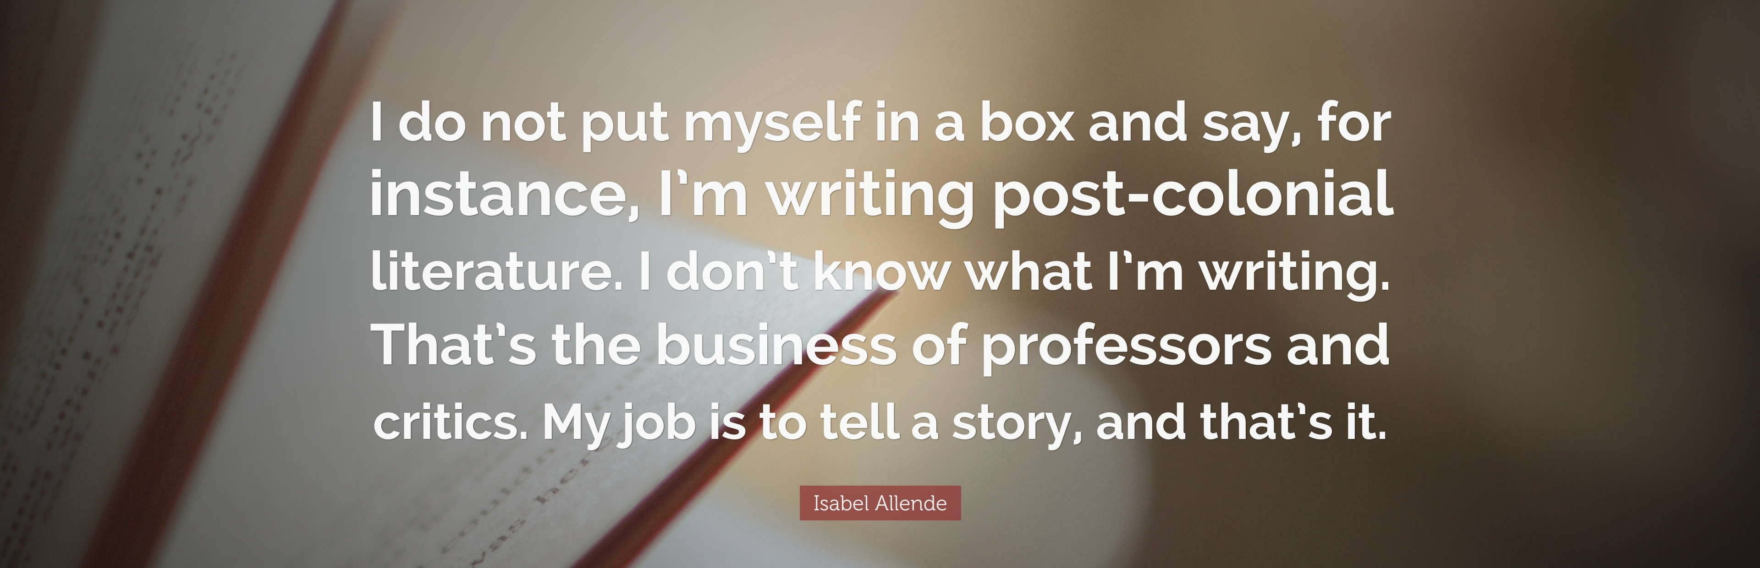
Post-Colonial Literary Criticism
Focuses on writings from former colonies from around the world
Attempts to understand problems posed by colonization and its aftermath, i.e. the legacy of colonialism and construction of the ‘oriental’ other
Often celebrates hybridity and resistance to Western hegemonic discourses

Slide 40
Postcolonial Criticism and Theory
Explores cultural identity in colonial and postcolonial societies
  Who were we then; who are we now?
NOT a reference solely to time, as in after colonization or after ‘independence’ from colonists
Deals with the legacy of colonial rule through literature (and other forms of expression)

Slide 41
Postcolonial Literary Criticism
School of thought and body of theoretical literature that comes out of the post-European empire period
Takes us back to colonized times and places to examine works (resurrect culture) either marginalized by or resistant to modern, imperialist constructs of history
Argues that most classical/canonical literature comes from the voices of white western writers, and that means the canon is usually written from the perspective of colonialism.
Indicates an evolution in academia to consider the untold stories of the oppressed and provides a critical lens for exposing the injustices suffered by oppressed groups and the contrast between their worldviews and the views of the oppressors.

Slide 42

Key Questions for Postcolonial Literary Criticism
►Examining relationship between colonizers/colonized
  Is the work pro/anti colonialist? Why?
  Does the text reinforce or resist colonialist ideology?
► Examining types of oppression
  What tools do the colonizers use to demean or oppress the colonized?
  What psychological aftermath are the colonized people left with?
  Considering the present as well as the past, is the author using the language of a colonizer?

Slide 43
Key Terms & Topics
Alterity – Being different than one’s community
Diaspora- Being forced as an ethnic culture to leave original homeland and dispersed throughout world
Eurocentrism –an emphasis on European or Western beliefs, often at expense of other cultures. Aligned with current and past power structures in the world.
Hybridity - The assimilation and adaptation of cultural practices, the cross-fertilization of cultures; can be seen as positive, enriching, and dynamic, as well as oppressive
-Social Darwinism
-Eurocentrism
-White Man’s Burden
* What was thought to be an obligation to “civilize” non-European people
-Racism
-Hegemony
-Exploitation
-Counter-narrative
-Cultural borderlands

Slide 44
Questions to prompt postcolonial analysis:
How does the literary text, explicitly or allegorically, represent various aspects of colonial oppression?
What does the text reveal about the problematics of post-colonial identity, including the relationship between personal and cultural identity within cultural borderlands?
What does the text reveal about the operations of cultural difference—the ways in which race, religion, class, cultural beliefs, and customs combine to form individual identity—in shaping our perceptions of ourselves, others, and the world in which we live?
What person(s) or groups does the work identify as "other" or stranger? How are such persons/groups described and treated?
What does the text reveal about the politics and/or psychology of anti-colonialist resistance?

Slide 45
When Writing about Race/Ethnicity
Don’t be afraid to be critical of an author’s portrayal of race. If it makes you uncomfortable, there’s probably something wrong with it.
Do not get sucked in to “positive stereotyping.” Casting the colonized or oppressed as a purely innocent, angelic culture or people to be pitied is almost as bad as demonizing. That’s not acknowledging complexity.
If you are white, this legacy can be difficult to accept. But it’s the history you inherited, so learn to deal with it now.
Any text, even one that doesn’t seem to be “about” race/culture, can be examined from a postcolonial lens.

Slide 46
Critical Approaches:
Marxist Criticism
New Historicism
Cultural Studies

Slide 47
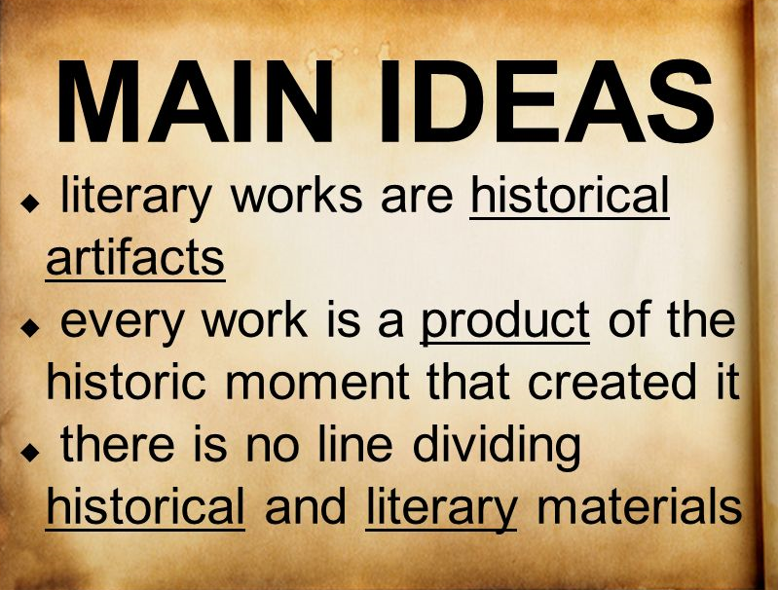
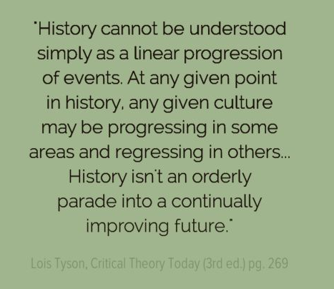
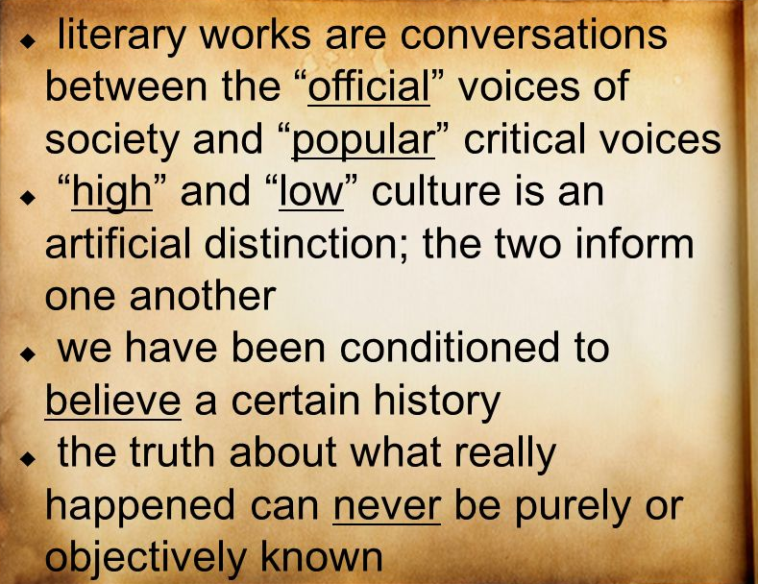
Marxist Criticism
New Historicism & Cultural Studies
Examines how socioeconomic forces and ideologies affect people’s lives and how such forces are represented in the text or even responsible for producing the text; often critiques capitalist and consumer culture
Focuses more on analysis of historical and cultural contexts that contribute to the construction/writing of texts
Emphasizes material conditions, ideologies, and practices surrounding literary production, including more popular forms of culture or the kinds of texts not often considered “literary”

Slide 48
Marxist Criticism
Bases approach largely on works of Karl Marx (1818-1883), German political philosopher.
Investigates assumptions and values associated with culture, race, class.
For example: Are the rich always good or bad? Are the poor always good or bad?
Explores the power struggles of those who are minorities in dominant culture.
Examines who has/does not have power, how they attained it/why they don’t have it, and what they do with it/how they are manipulated by it.
Believes that literature is essentially political; it either supports or refutes economic oppression. In other words, the author either reinforces the status quo or rebels against it.
Marxist critics apply these economic and social theories to literature by analyzing:
  Ideologies that support the elite and place the working class at a disadvantage
  Class conflict
Marxism strongly influenced fiction, particularly American fiction, in the 1930s.

Slide 49
New Historicism
New historicist critics view literature as part of history, and furthermore, as an expression of forces on history.
New historicism compares literary analysis to a dynamic circle:
  The work tells us something about the surrounding ideology (slavery, rights of women, etc.)
  Study of the ideology tells us something about the work.
New historicism takes two forms:
  Analysis of the work in the context in which it was created
  Analysis of the work in the context in which it was critically evaluated.
New historicists assert that literature “does not exist outside time and place and cannot be interpreted without reference to the era in which it was written” (Kirszner and Mandell 2038).
Readers are influenced by their culture, so no objective reading of a work is possible.
Critics should consider how their own culture affects their interpretation of the historical influence on a work.

Slide 50
NEW HISTORICISM—Key Arguments
Literature is one among many socially constructed texts. If there is a difference, it’s the intentional use of the imagination to convey ideas.
History is every bit as subjective as intentionally imaginative texts
Purpose of analyzing literature is to locate hidden social messages, especially those that promote oppression.
Texts have no final interpretation
Language, though socially constructed, is stable enough to be useful.
Find a small intriguing or odd piece of the text and interpret it by comparing it to contemporary sign systems—magazines, newspapers, fads, laws. Try to locate uses & abuses of power.

Slide 51
Cultural Studies
“Culture” is hard to define and so is “cultural studies”
It is not so much a discrete approach as a set of practices influenced by many fields
It concentrates on social and cultural forces that either create community or cause division and alienation
Four goals:
  transcending confines of a particular discipline
  remaining politically engaged
  denying the separation of high and low culture
  analyzing the means of production as well as product
Joins subjectivity to engagement

Slide 52
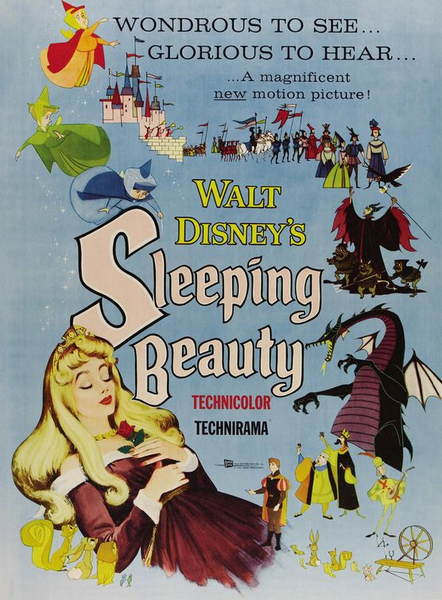
Historical/Cultural Reading of Disney’s Sleeping Beauty (1959)
What can Sleeping Beauty reveal about 1950s society?
How do Prince Phillip’s lines and the “Sword of Truth” reflect the ideals of 1950s Americans?

